Slide 1
PASSENGER CONTROL IN SMART CITIES USING DEEP LEARNING
Project guide : Assistant professor Mrs . Sheethal M S
Group members : Delna T D
: Dhanya P Pauly
: Dona Johnson
: Jesta Jose

Slide 2
INTRODUCTION
Introducing “Passenger control in smart cities using deep learning ” with increased accuracy in prediction.
System predict the number of passengers in the vehicle and the load.
Detect the number of passenger in the vehicle using deep learning.
Number of passengers beyond a limit is not encouraged to travel in the vehicle.
Proposed system will detect the overload and passenger count then displayed in the system in front of the driver driver.

Slide 3
PROBLEM STATEMENT
Passenger overload leads to :
The driver’s control and operating space in the overloaded vehicle are diminished.
The overloaded vehicle cannot accelerate as normal .
Seat belts are often not used as the aim is to pack in as many persons as possible into the vehicle .
Brakes overheat and lose their effectiveness to stop the car. These all leads to accidents.

Slide 4
Health problems during travelling.
Carelessness about the passengers after the parking.

Slide 5
PROJECT AREA
Deep Learning .
Deep learning is used to train the system with the data.

Slide 6
System architecture
OVERLOAD DETECTION
CAMERA
PREPROCESS
SEGMENTATION
DATA ANALYSING
DETECTION
CLASSIFICATION DNN
OVERLOAD DETECTION & DISPLAY

Slide 7
Module description
CAMERA
To take the real time video inside the vehicle.
PREPROCESS
Noise calculation : Sense to supress the noise on preprocessing data. Noise to be reduced to avoid complexity in problems.
Grayscale conversion : conversion of colour image into grayscale image. It reducing a lot of information which are not required and also will save lot of computational power as well.
Threshold : Threshold image analysis technique is a type of image segmentation that isolates objects by converting grayscale images into binary images.

Slide 8
Module description
Canny :The Canny edge detector is an edge detection operator that uses a multi-stage algorithm to detect a wide range of edges in images
SEGMENTATION
Segmentation is the process of partitioning a digital image into multiple segments. The goal of segmentation is to simplify OR change the representation into something that is more meaningful and easier to analyze.

Slide 9
Module description
Contouring :Contours can be explained simply as a curve joining all the continuous points , having same color or intensity. The contouring is a useful tool for shape analysis , object detection and recognition.
CLASSIFICATION DNN
Classifies the images into person ,handbag and suitcase using Deep Neural Network.
DETECTION & DISPLAY
Number of passengers detected then average weight is detected and displayed on the screen.
DATA ANALYSING
Data analysis is a process for obtaining raw data and converting it into information useful for decision-making by users.

Slide 10
Hardware
CAMERA
A camera is an optical instrument used to record images. cameras are sealed boxes with small hole that let light in to capture an image on a light-sensitive surface.
Here camera capture the image that to be used to count the number of passengers occupied in the vehicle.
SYSTEM
A system with WINDOWS 10.

Slide 11
Software
Windows 10
Windows 10 is a computer operating system by Microsoft as part of it’s windows family of operating systems.
Windows 10 is designed to provide a common, “universal“ user interface between desktop, laptop and all in one PCs, tablet computers, smartphones .
Improved compatibility and speed in browsing.
App store is available .

Slide 12
Software
Python
Python is an interpreted high-level programming language for general-purpose programming.
Python has a design philosophy that emphasizes code readability, notably using significant white space.
Python is an open source language.
Google Colab
Google Colab is a free cloud service.
Improve Python programming language coding skills.
Develop deep learning applications using popular libraries such as Keras, TensorFlow, PyTorch, and OpenCV.

Slide 13
Software
YOLO
Real-Time Object Detection. You only look once (YOLO) is a state-of-the-art, real-time object detection system.
YOLO is a clever neural network for doing object detection in real-time.
YOLO is a convolutional neural network based model that detects objects in real time using the "You Only Look Once" framework.
Anaconda 3
Anaconda is a free and open-source distribution of the Python and R programming languages for scientific computing.
Spyder, the Scientific Python Development Environment, is a free integrated development environment (IDE) that is included with Anaconda.
That aims to simplify package management and deployment.

Slide 14
Software
Open CV
OpenCV ( Open source computer vision) is a library of programming functions mainly aimed at real-time computer vision.
OpenCV is an open source computer vision and machine learning software library.
OpenCV was built to provide a common infrastructure for computer vision applications and to accelerate the use of machine perception in the commercial products.

Slide 15
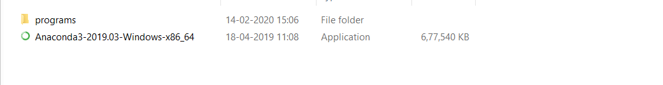
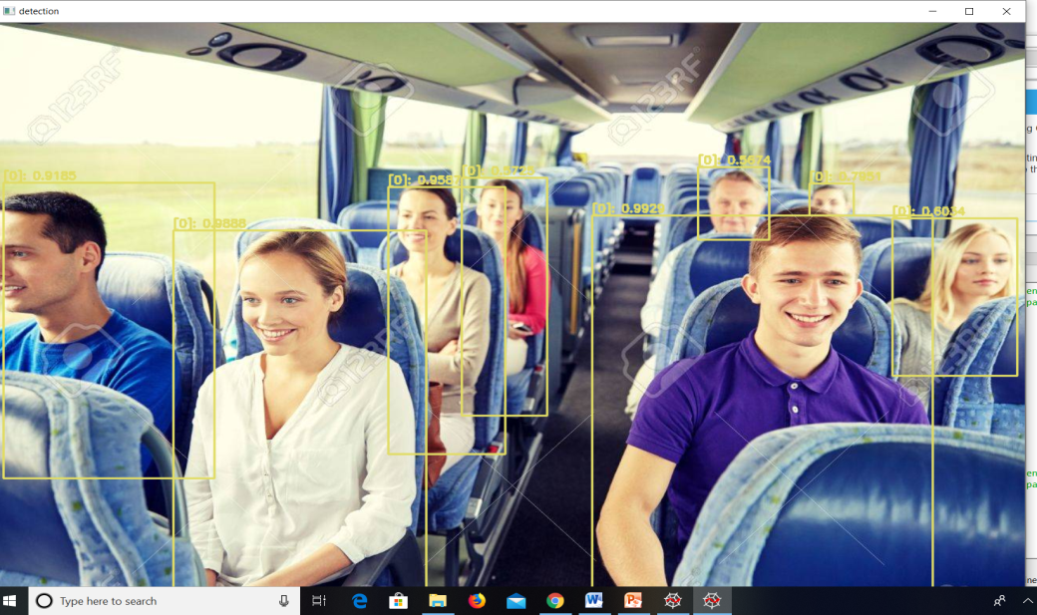

IMPLEMENTATION
Anaconda installed
Training and testing of passenger completed

Slide 16
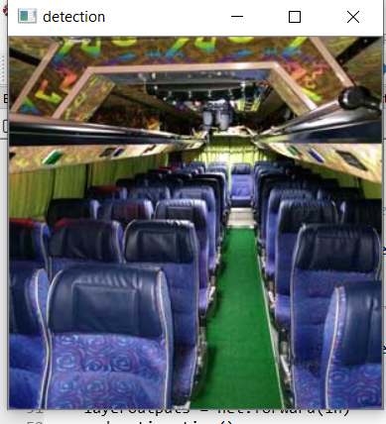

IMPLEMENTATION

Slide 17
THANK YOU

